Slide 1
Henry Moore
A sculptor

Slide 2
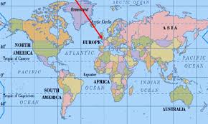
Henry Moore
He was born in 1898 in a small town in England
117 years ago!
At 10 years old he told his father that he wanted to be a sculptor when he grew up

Slide 3
What is a Sculptor?
An artist who shapes and molds materials
Why is it different than painting?
It is three dimensional – 3D
You can touch and feel it

Slide 4
Background Information
Henry Moore fought in World War 1
After he studied at an art school where he had a wonderful teacher who influenced him
Henry worked very hard and visited museums to study and learn from the art
At 27, Henry finished his studies and started a career as a sculptor

Slide 5
Career
Henry became a stone carving sculptor - he liked to work with hard materials and cut away at them
His work was very ABSTRACT
People thought his sculptures needed to be REALISTIC
He did not give up

Slide 6
Career
Henry got married and had a daughter
He used the idea of mother and child a lot in his artwork
He first sketched his ideas and then brought them to life with his sculptures
He also made small models of his sketches and then turned them into giant sculptures sometimes as big as this room

Slide 7
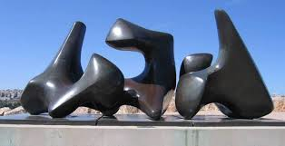
Look how BIG!!!

Slide 8
Negative Space
Many of Henry Moore’s sculptures had negative space – holes you can see through
After 20 years people everywhere started to appreciate and enjoy his artwork, and he became very well known
He was hired to create sculptures for parks and gardens in cities all over the world. He wanted his sculptures to be outdoors, so people could touch and even climb on them

Slide 9
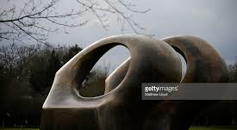
Negative Space

Slide 10
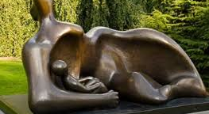
Mother and Daughter

Slide 11
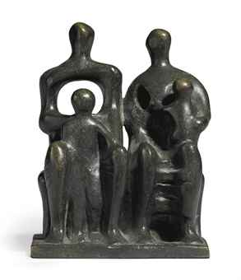

Slide 12
Activity
Today you are going to become a sculptor and create a sculpture in the style of Henry Moore
Think about his artwork
Remember he 1st sketched his work and then he created a 3D sculpture.
Think about his use of negative space and love of simple figures
1st sketch you will sketch your idea and then create your masterpiece with clay. HAVE FUN and be CREATIVE!!!

