Slide 1
Jasper Johns
Art Appreciation
Ms. Dawson’s Class

Slide 2
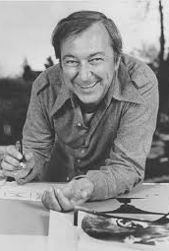
Childhood
Born on May 15, 1930 in Atlanta, Georgia
Grew up living with his grandfather
Drew and painted throughout his childhood
Attended the University of South Carolina
Moved to New York after two years of study

Slide 3
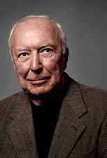
Adulthood
Johns helped to create window displays as a struggling artist
At the age of 24 Johns destroyed all of his artwork so that he could “stop becoming and be an artist”
He wanted to start a new beginning, free of any influence from other artists
In 1954 Johns dreamed he was painting a large American flag. The next morning, he went out and bought what he needed to start it.

Slide 4
Jasper Johns As An Artist
Jasper Johns was an artist for 40 years.
He used beeswax, lighter fluid, oil stain, plaster casts, crayon, charcoal, chalk, cardboard, ink and fabric.
In 1958, Jasper Johns had his first art show and he became famous overnight.
Later in his life, Johns moved from paintings to sculptures.

Slide 5
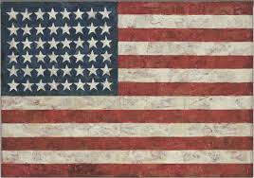
Flag
“One night I dreamed that I painted a large American flag,” Johns has said of this work, “and the next morning I got up and I went out and bought the materials to begin it.” Those materials included three canvases that he mounted on plywood, strips of newspaper, and encaustic paint—a mixture of paint and hot wax that forms a surface of lumps and smears and dries quickly. There are newspaper scraps visible beneath the stripes and forty-eight stars.
This painting sold at auction for $28.6 million.

Slide 6
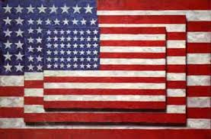
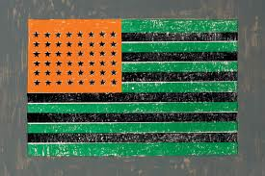
Green and Orange Flag
Three Flags

Slide 7
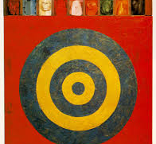
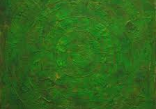
Target and Green Target

Slide 8
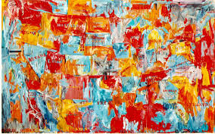
Map

Slide 9
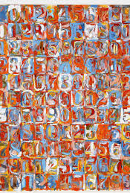
Numbers

Slide 10
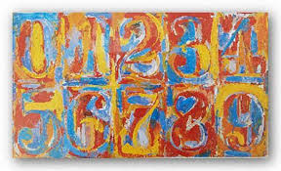
0 Through 9

Slide 11
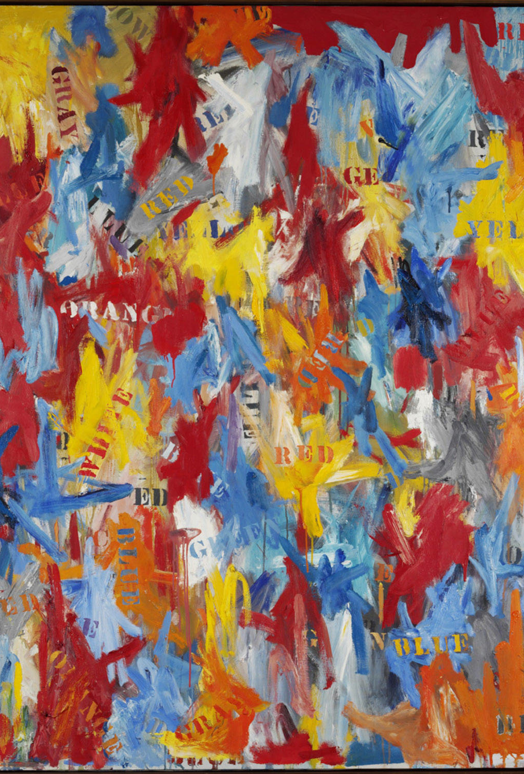
False Start

Slide 12
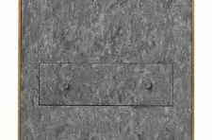
Drawer

Slide 13
A Song About Jasper Johns
Motifs: ideas that you see over and over again in artwork
“What does it mean? What it is he trying to say?” There is one to look at it. Are there other ways?”

Slide 14
Observations
Johns used objects around him in the world
He used everyday images but put his personal touch on them. Johns said, “Take an object. Do something to it. Do something else to it.”
He uses repetition of colors, shapes and lines
Jasper Johns encourages us to look at familiar symbols with new eyes

Slide 15
Your Mission
Create artwork using something that looks familiar to you – YOUR NAME!
Use repetition (color, shape and line) to write your name over and over again
Use oil pastels to write your name and watercolors to fill in the boxes
Have fun!

